Slide 1
Crash Course C++ 11

Slide 2
Agenda
New C++11 Features incl. Keywords, enum class, smart pointers, lambda
New C++14-17 Features incl.
Libraries incl. Chrono, Future, Regex, Thread, Atomic
Callback functions

Slide 3
New C++11 Features
Keywords (nullptr, auto, override)
Lambda expressions
Enum class
Smart pointers

Slide 4
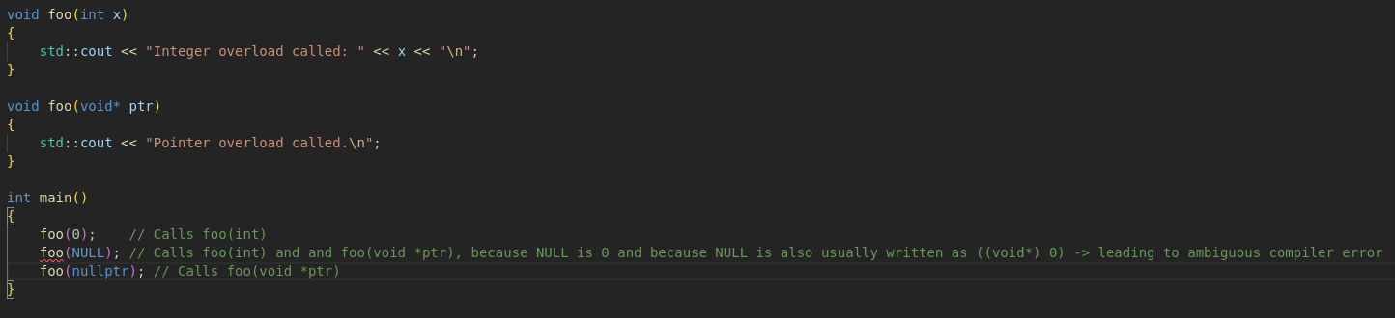
Nullptr
Replaces NULL after c++11
Improves type safety
Example:

Slide 5
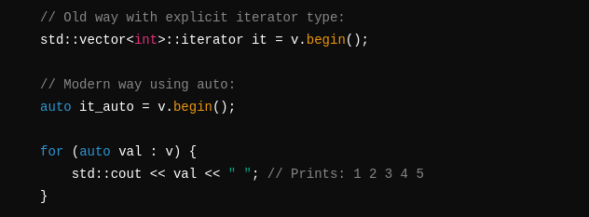
Auto
Provides type deduction by the compiler
Syntax: auto needs to be initialized at the point of declaration
Example:
Most useful when using type inference in containers
Example:

Slide 6
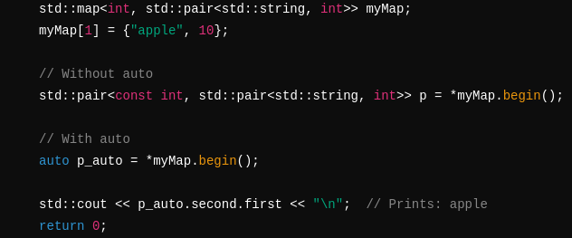
Auto
Another Example for text simplification:

Slide 7
Auto
What to look out for:
1. Const and static declaration need to be explicitly set, auto does not automatically deduce these.
Example:

Slide 8
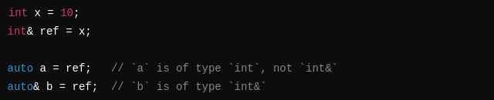
Auto
2. Decay
Decay means certain types undergo transformations
Examples:

Slide 9
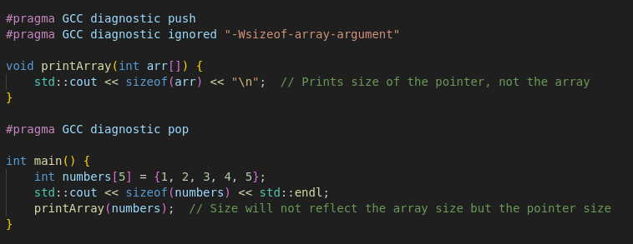
Auto
Question: What happens when I try to do sizeof(ptr) compared to arr[]?
Provide an explanation on these use cases of array decay!

Slide 10
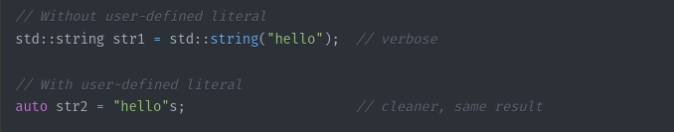
Auto Additions C++14
Since C++14 it is possible to auto deduct functions.
Example: auto add(int a, int b) { return a + b; }
Also it is now possible to auto deduct standard library types
  By using User-defined literals (operator”” _ )
Example: std::string → auto str = “Hello”s; ← s as literals for deduction
Std::chrono → auto duration = 42s; ← number + s combination for deduction
Also requires manual definition or using namespace std::literals
Example:

Slide 11
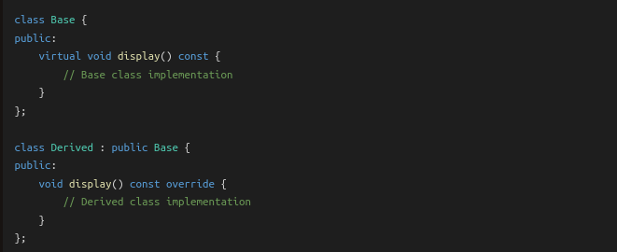
Override
New Safety Feature for Derived classes
Throws an error if there is no base class virtual function that you want to override
Syntax:

Slide 12
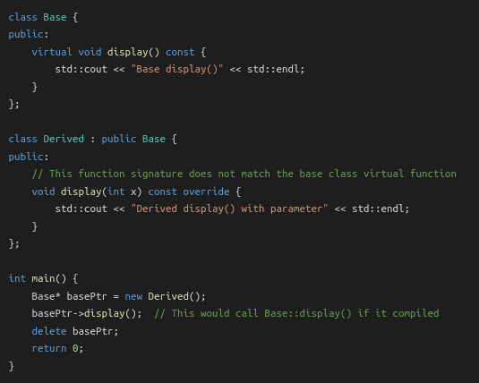
Override
So when does it throw an error?
Example:
Throws compiler error: 'void Derived::display(int) const' marked 'override', but does not override

Slide 13
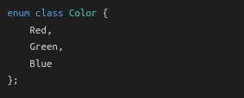
Enum Class
New Safety Feature for Enums
Also known as scoped enumeration
Syntax:

Slide 14
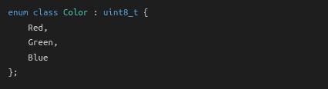
Enum Class
Strongly typed means no implicit type conversion as with enum
  enum on default was always 0 1 2 3 etc..
enum class cannot be converted implicitly
To convert you need to explicitly cast it like so:
It is possible to specify the underlying values when first declaring the enum class like so:

Slide 15
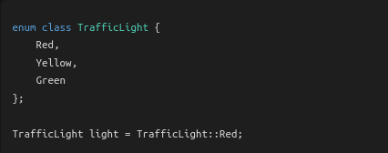
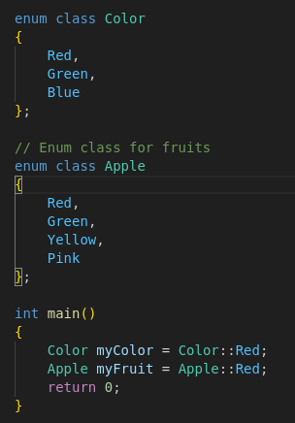
Enum Class
Benefits:
Type Safety:
Avoid Name Clashes:

Slide 16
Smart Pointers
Utility: Improved memory management
Part of the <memory> library
Consist of 3 different pointer types:
1. Unique_ptr
2. shared_ptr
3. weak_ptr
When either of these pointers lose the last occurrence of their variable
For example by going out of scope, they automatically get deleted! No need for memory management!

Slide 17
Smart Pointers
Unique_ptr:
Provides unique ownership of an allocated object/variable
Syntax:
Can only have one variable at a time holding the pointer!
To transfer ownership needs to utilize std::move(new var)

Slide 18
Smart Pointers
Unique_ptr:
What to look out for!:
  Passing the ptr to another function needs to happen by reference,
  If you want to be able to keep the result of the operations inside of the passed function,
  Otherwise a copy of the variable will be created on pass instead!
Example on next pages:

Slide 19
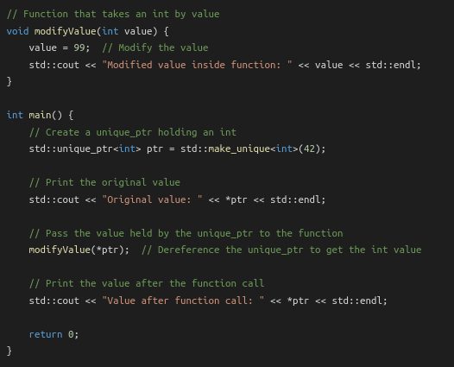

Smart Pointers
Will result in:

Slide 20
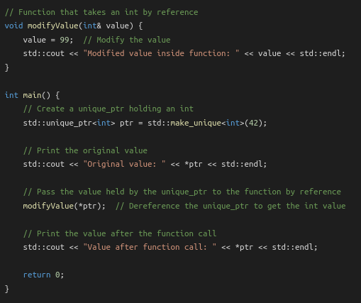

Smart Pointers
“Correct” Behaviour:
Will result in:

Slide 21
Smart Pointers
Shared_ptr:
Provides shared ownership of an object/variable
Syntax:
Shares Ownership with each other shared pointer assigned its value → This means that each change to the shared value changes the value for every shared pointer!
Example on next page:

Slide 22
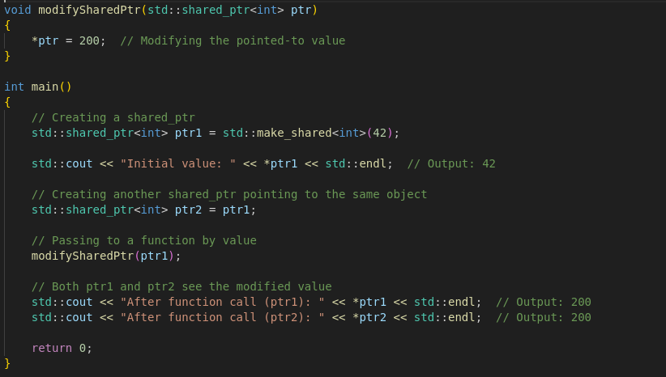
Smart Pointers
Shared_ptr example:

Slide 23
Smart Pointers
Shared_ptr:
What to look out for:
  Extended Lifetime, Cyclic references, overwriting values!
  Shared pointers will only be deleted from memory when the last occurrence of all shared pointers holding the same value go out of scope!
  If two shared pointers reference each other we can get a cyclic reference
  Overwriting values, pretty self explanatory, in tricky cases like asynchronous operations though, they can get confusing fast!
  Examples on next pages:

Slide 24
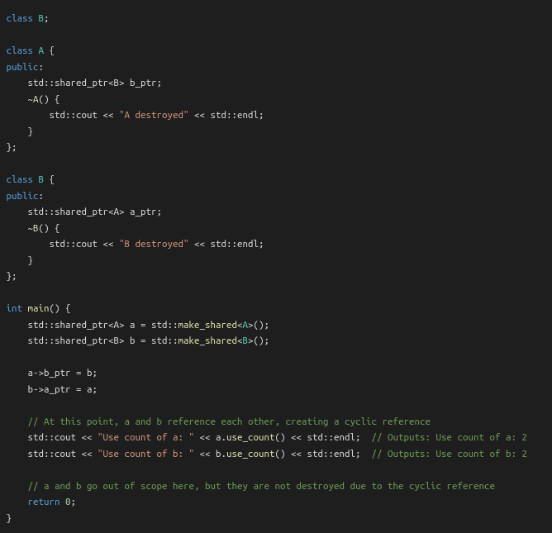
Smart Pointers
Cyclic reference:

Slide 25
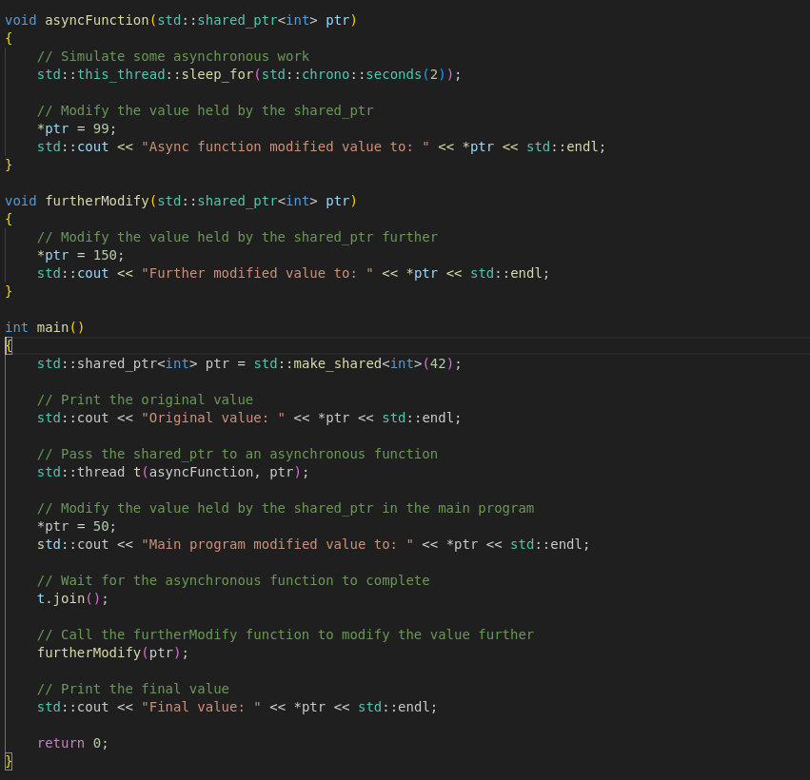
Smart Pointers
Overwriting Values:

Slide 26
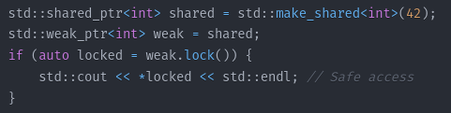
Smart Pointers
weak_ptr:
Holds a non-owning reference to an object managed by a shared_ptr
Must be converted to a shared_ptr to access the object
Syntax:
Use Case:
  To break circular references between shared_ptrs

Slide 27
Smart Pointers
Best Practices:
  1. Use unique_ptrs over shared_ptrs for exception safety and efficiency
  2. use weak_ptrs to break circular references
  3. Avoid mixing raw pointers and smart pointers for the same resource/object/var

Slide 28
Lambda Expressions
Also known as closures are anonymous functions
Syntax: [capture](parameters) → return_type
{
function body
}
Typically used with STL algorithms like std::sort etc..

Slide 29
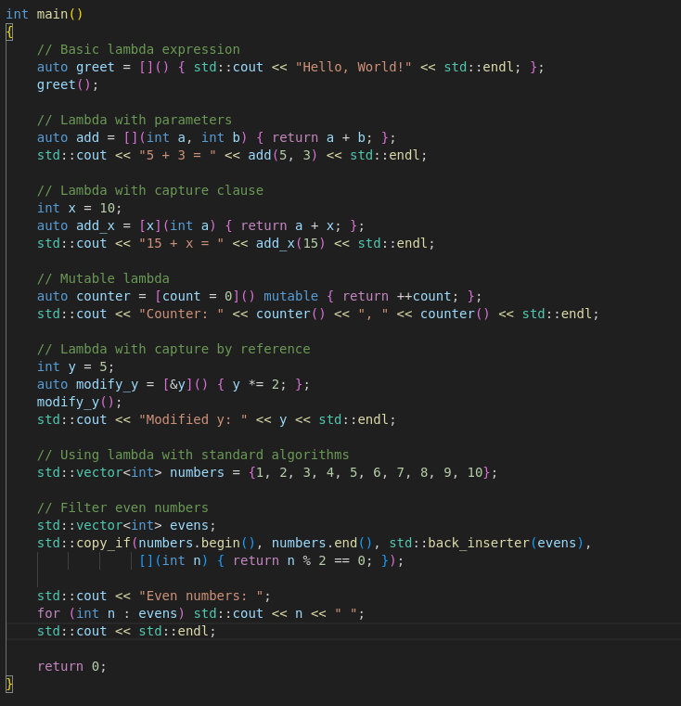
Lambda Expressions
Code Examples:

Slide 30
Short Break
5-10 minutes

Slide 31
New C++17 Features
Structured Bindings
if/switch Initializers
Template argument Deduction

Slide 32
Structured Bindings
Decompose arrays, tuples, structs, maps, etc.. into single variables
Example:
  auto [x, y, z] = getTuple()
    X → int
    Y → double
    Z → std::string

Slide 33
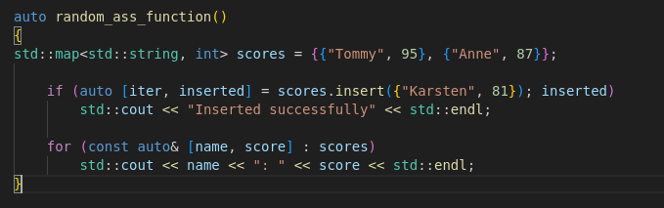
Structured Bindings
Common Use Cases:
  Map operations like insertion, iteration and lookups
  Multiple return values
  Working with Coordinates/Vectors for graphics or mathematical computations
  Database operations like Row results, Query Status etc…
  Map Example:

Slide 34
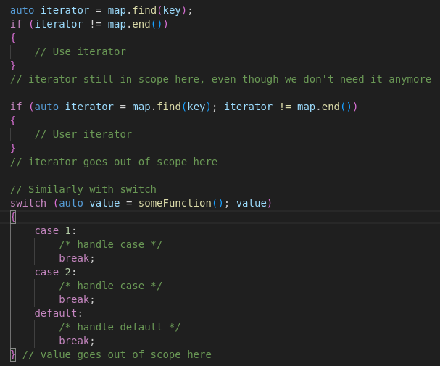
If/switch Initializers
Initialization of variable && using it only in scope
Old Way:
New Way:

Slide 35
Template Argument Deduction
Simplifies Deduction for Class Templates
Example: std::pair p(2, 4.5);
instead of: std::pair<int, double> p(2, 4.5);

Slide 36
Short Break
5-10 minutes

Slide 37
New C++ 11 Libraries
A look into:
Chrono - Time Library
Thread – MultiThreading Library
Mutex – Mutex Library
Condition_variable – condition variables Library
Atomic – Atomic operations
Future – Asynchronous Library
Regex – Regular expressions

Slide 38
Chrono
#Include <chrono>
Main Components:
  Durations
  Time points
  Clocks
Namespace: std::chrono

Slide 39
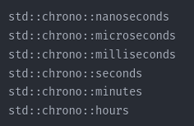
Chrono
Durations:
Duration casting syntax:

Slide 40


Chrono
Timepoints are a combination of clock and duration, represented by the std::chrono::time_point template
Examples:
ex. Now < later

Slide 41
Chrono
Clocks: represent different time measurement tools that can measure time differently
Chrono uses 3 different clocks:
  std::chrono::system_clock wall clock time
  std::chrono::steady_clock monotonic clock (never adjusted)
  std::chrono::high_resolution_clock highest precision clock
Each come with their own benefits and drawbacks (performance, accuracy etc..)

Slide 42

Chrono
Chrono also supports conversion from and to other time formats such as time_t for example.

Slide 43
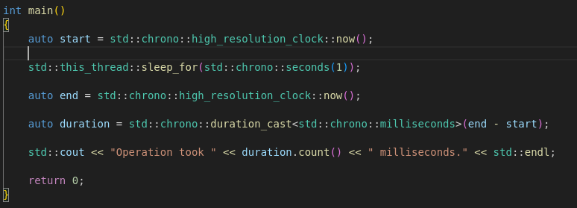
Chrono
Code example:

Slide 44
Thread
Include <thread>
Components:
  Std::thread class
  Std::this_thread namespace
  Std::thread::id type

Slide 45
Thread
Std::Thread:
Classic Thread representation
Can be initialized in multiple different ways using functions, functors(function objects) and lambda expressions.
Classic join, detach functionality calling .join or .detach on the thread class object
Also implements condition checks for error management.
Example: Always call thread.joinable() to check if join can be called!
Beware the threads will be automatically deleted once the function goes out of scope, so a call to join() or detach() is necessary or the program terminates!

Slide 46
Thread
Std::this_thread namespace:
Hand the thread class core functionalities like:
  get_id() returns the id of the current thread
  Yield() suggests reschedule of thread execution
  sleep_for() blocks calling thread for duration
  sleep_until() blocks calling thread until time_point

Slide 47
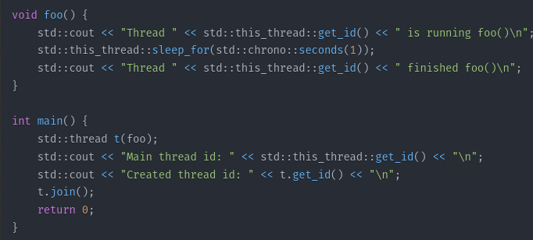
Thread
Example:

Slide 48
Mutex
Include <mutex>
Components:
  Mutex Types
    Mutex
    timed_mutex
    (I will exclude recursive mutexes and timed recursive mutexes)
  Lock Types
    lock_guard
    unique_lock

Slide 49
Mutex
Std::mutex
Classic mutex representation
Requires manual lock / unlocking
Can cause deadlocks just like in C
Created using: std::mutex <name>
Functionality:
  mutex.lock() → classic lock
  mutex.try_lock() → attempts locking, in case of failure returns immediately
  mutex.unlock() → classic unlock

Slide 50
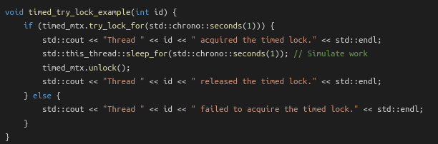
Mutex
Std::timed_mutex
Timed mutex
Requires manual lock / unlocking
Compared to normal mutex → can unlock after certain time
  No deadlocks
Created using: std::timed_mutex <name>
Functionality:
  mutex.lock() → classic lock
  timed_Mutex.try_lock() → attempts lock, in case of failure immediately returns
  timed_mutex.try_lock_for(duration) → attemps locking until duration is over then returns in case of failure
  timed_mutex.try_lock_until(timepoint) → attempts lockung until reaching timepoint, then returns in case of failure
  mutex.unlock() → classic unlock

Slide 51
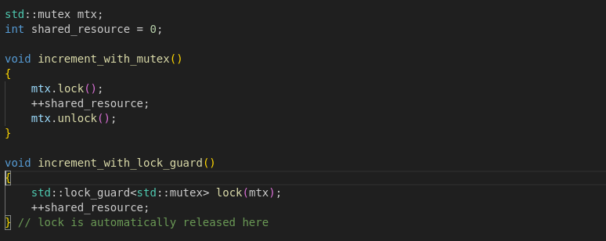
Mutex
Std::lock_guard
Used in combination with a mutex, automatically unlocks
a mutex once it goes out of scope.
Simplifies syntax and code clarity
Syntax: std::lock_guard<std::mutex> lockvar(“mutexvar”)
Example:

Slide 52
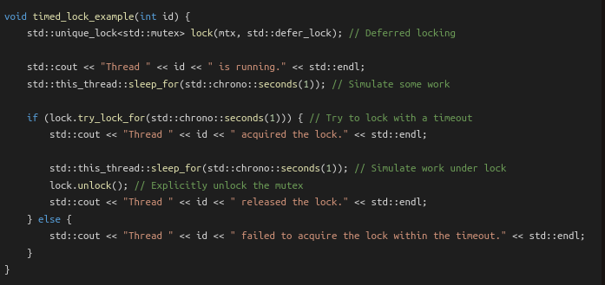
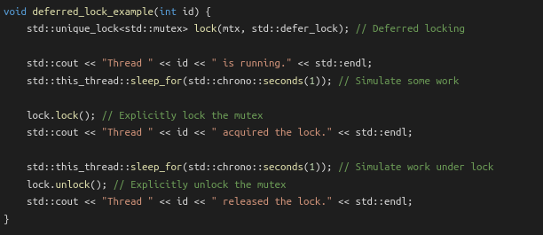
Mutex
Std::unique_lock
Just like lock_guard, automatically unlocks a mutex once it goes out of scope.
Can apply timed locking onto any kind of mutex
Can defer locking until a later date
Syntax: std::unique_lock<std::mutex> lockvar(“mutexvar”)
Examples:

Slide 53
Condition_variable
#include <condition_variable>
Components:
  Std::condition_variable
  Provide additional support to mutexes && locks
  Main operations:
    Wait(lock) → puts calling thread to sleep and unlocks mutex. Reacquires lock on wake up notification.
    Wait(lock, condition) → puts calling thread to sleep and unlocks mutex, wakes up on evaluating condition to true
    notify_one() → Wakes up any one waiting thread
    notify_all() → wakes up all waiting threads
    wait_for(lock, duration) → waits for notification for a specified duration
    wait_until(lock, time_point) → wait for notification until a specific time point

Slide 54
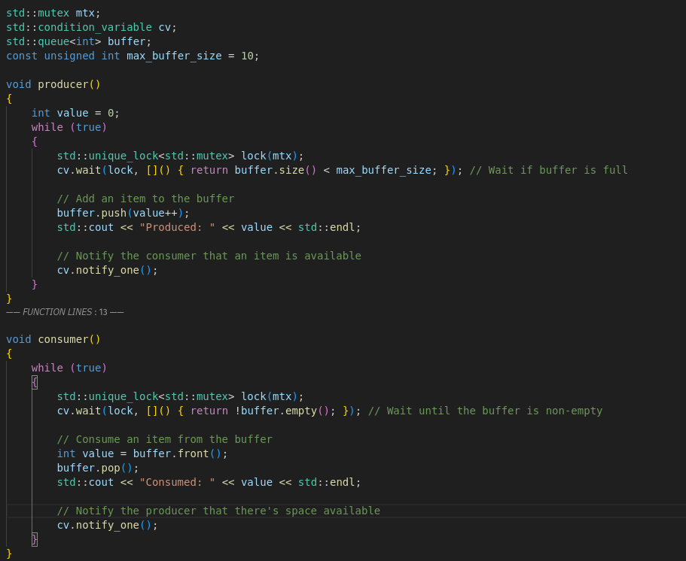
Condition_variable
Example Usage:

Slide 55
Atomic
#include <atomic>
What are atomic operations?
Std::atomic
Std::atomic functions

Slide 56
Atomic
What are atomic operations?
  Atomic operations perform a single indivisible step
    Meaning they cannot be interrupted by other threads in a multithreaded application
    Meaning they are thread safe operations with which you can for example increment a value without needing mutexes
    Also more efficient than mutexes in terms of performance, since they are implemented using low level hardware-instructions like CAS(Compare and swap), Test-and-Set and LL/SC(Load-link/store-conditional)

Slide 57
Atomic
Std::atomic
Can be used to make primitive types like: integers,pointers etc.. atomic
Declaration syntax: std::atomic<type> var(value)
Provided features are:
  Loads
  Stores
  fetch_operations
  compare_operations
  memory_ordering (will skip this)
  Specialized atomic types like std::atomic flag (will also skip this)

Slide 58
Atomic
Load()
Syntax: int val = atomic_var.load()
Atomically reads values
Store()
Syntax: atomic_var.store(5)
Atomically stores values

Slide 59
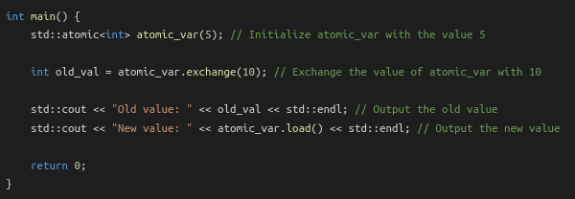
Atomic
exchange():
Syntax: int old_val = atomic_var.exchange(10)
Atomically exchanges the values, basically performing a swap
Also has other exchanges (compare_exchange_weak and compare_exchange_strong)

Slide 60
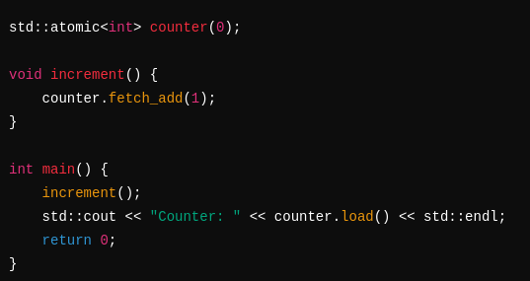
Atomic
fetch_operations:
Syntax: atomic_var.fetch_add(val)/_sub(val)/_and(val)/_or(val)/_xor(val)
Atomically adds, subtracts, uses bitwise and/or/xor operations

Slide 61
Future
#include <future>
What are futures?
Components:
Std::future
Std::promise
Std::async
Std::shared_future (will skip this)
Std::packaged_task (will also skip this)

Slide 62
Future
What are Futures?
  Futures provide a way to handle asynchronous operations
  What are asynchronous operations?
    Asynchronous operations are routines executed independantly of the running program
    They are useful to delegate processing intensive operations to run concurrent to the active program such as I/O operations, network requests or complex calculations.
    Once the result of the operation is required it can be requested from the asynchronous operation

Slide 63
Future
What are Futures?
  Imagine a scenario where you main program needs to wait and accept requests it gets sent, but also needs to process these requests and send answers.
  Traditionally you would spawn threads or child processes that handle these requests
  Now if I had thousands or even millions of requests your CPU and even big data servers would need an incredible amount of resources just to manage all these running threads and processes
  Asynchronous programming models use event-driven programming which improve the scalability, resource efficiency, responsiveness, and utilization of I/O resources since they don’t block like waiting threads or processes.

Slide 64
Future
So how do we use Futures?
Std::future:
  Read-only handle to a result of an async operation
  Allways paired with std::promise or created by std::async
Std::promise
  Write-only handle used to set a value for a std::future
  This is the producer of a value while future is the consumer

Slide 65
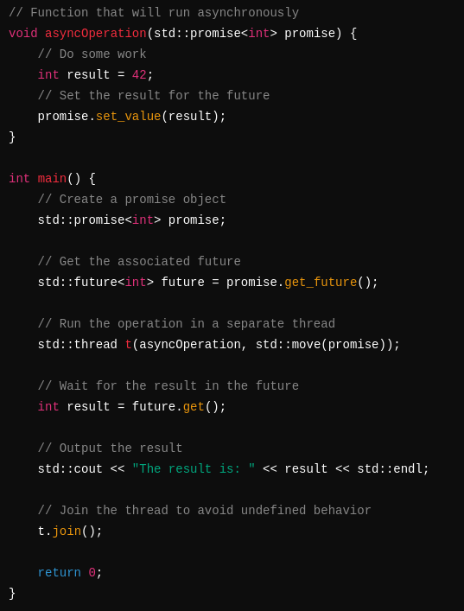
Future

Slide 66
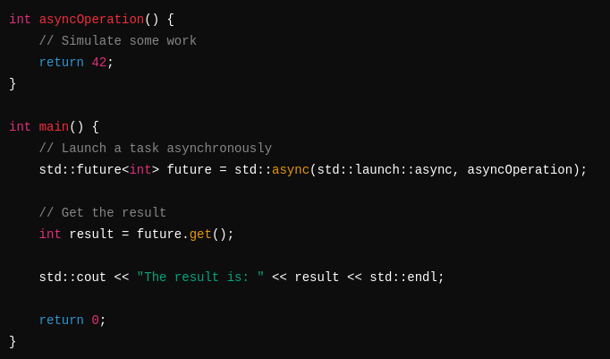
Future
So how do we use Futures?
Std::Async
  Launches an asynchronous operation, simplifying the promise/future logic

Slide 67
Regex
#include <regex>
What are regular expressions?
Components:
  Regular expression support
  That’s it

Slide 68
Regex
What are regular expressions?
  Regular expressions are a pattern matching tool used for string matching, text search and replace, input validation and data extraction
Basic regex patterns:
. : Matches any character except newline
^ : Matches the start of a string
$ : Matches the end of a string
* : Matches 0 or more repetitions
+ : Matches 1 or more repetitions
? : Matches 0 or 1 repetition
\d : Matches any digit (0-9)
\w : Matches any alphanumeric character
\s : Matches any whitespace character

Slide 69
Regex
Common regex functions and functor:
  regex_match() → checks if an entire string matches a regex
  regex_search() → searches for a regex match inside a string
  regex_replace() → replaces regex matches in a string
  sregex_iterator() → functor to iterate over regex matches

Slide 70
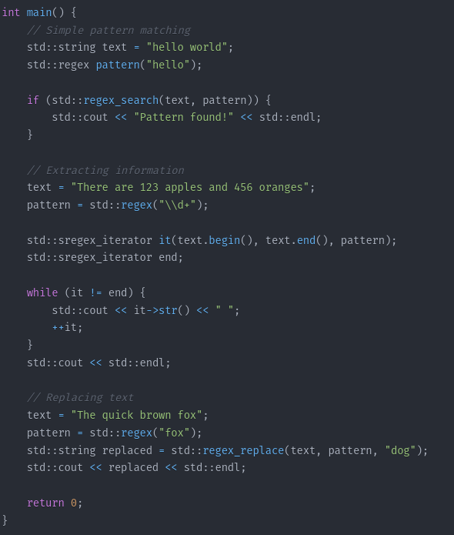
Regex
Examples:

Slide 71
New C++ 17 Libraries
A look into:
Filesystem – File management library
Optional – optional values
Variant – type safe unions
string_view – efficient references to string data
Parallel Algorithms – Parallel algorithms versions to <algorithm>

Slide 72
Option: Short Break
5-10 minutes

Slide 73
Option: End after Filesystem
No Break

Slide 74
Filesystem
Skip to End Button

Slide 75
What’s Next?
Please give me feedback on the idea of bringing closer Programming Concepts like
  RAII(Resource Acquisition is Initialization),
  Copy and Swap,
  Pointer to Implementation,
  Rule of Three/Five
  Policy-Based Design
  Metaprogramming
  Etc…
OR:

Slide 76
What’s Next?
Give more info on missed out core concepts like
  R/L-Values
  Move Semantics (Perfect Forwarding etc..)
  Stream Deep Dive: FileStreams, Ostreams, Istreams, etc..
  Type Traits && SFINAE (substitution failure is not an error)
  User-defined Literals
  Utility Features like std::byte, std::any, std:invoke, std::apply
  Stuff in C++20 and further..

Slide 77
Thank you for watching

